Slide 1

OCR INTEGRATED DATABASE SOLUTION
By:
Dharmi Gala (A014)
Dhruv Goyal (A018)
Aman Jain (A021)
Mahi Shah (A037)
Mentored by:
Prof. Shraddha Sarode
Prof. Prashant Dhamale
Notes:
#add flow of ppt

Slide 2
TABLE OF CONTENTS
1. Objective
2. Introduction on OCR
3. Libraries and Programs used
4. Database Description
5. Procedure
6. Accuracy
7. Conclusion
8. Limitations
9. Future Scope
Notes:
Libraries and

Slide 3

To create a system aimed at improving the speed and efficiency of manual database creation for identity verification by automation of the process.
OBJECTIVE

Slide 4
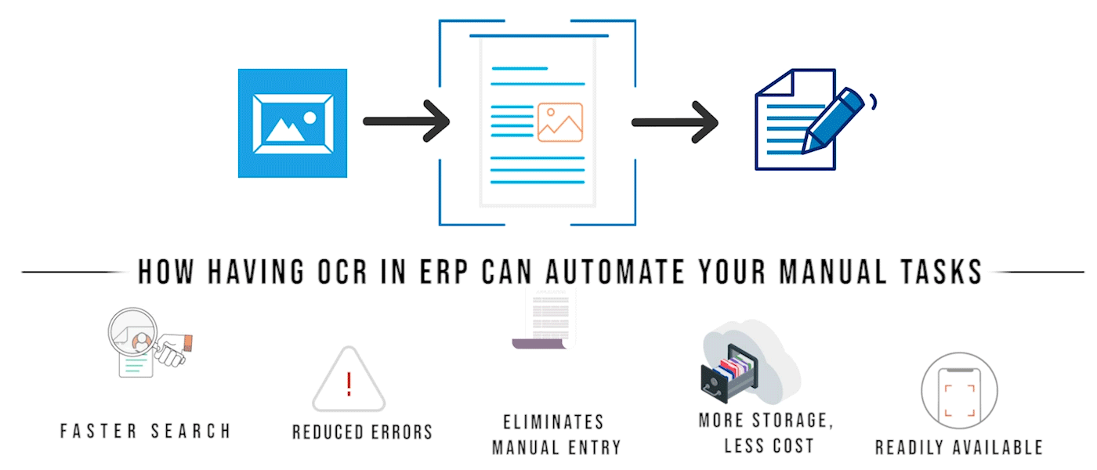

Slide 5
LIBRARIES AND PROGRAMS
Optical Character Recognition (OCR)
Widespread technology to recognize text inside images
Used to convert images containing written text into machine-readable text data
OpenCV
Open-source library that processes images and videos to identify objects, faces, or even the handwriting of a human
Pytesseract
Tool that will recognize and “read” the text embedded in images
Macros
Helps in automating or repeating tasks by recording one’s input sequences
VBA (Visual Basics for Applications) is used to write Macros
Notes:
Libraries and

Slide 6
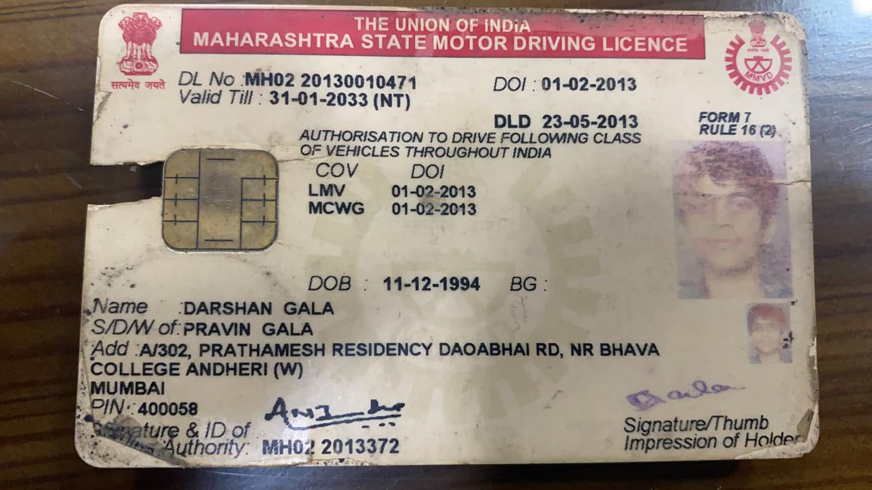
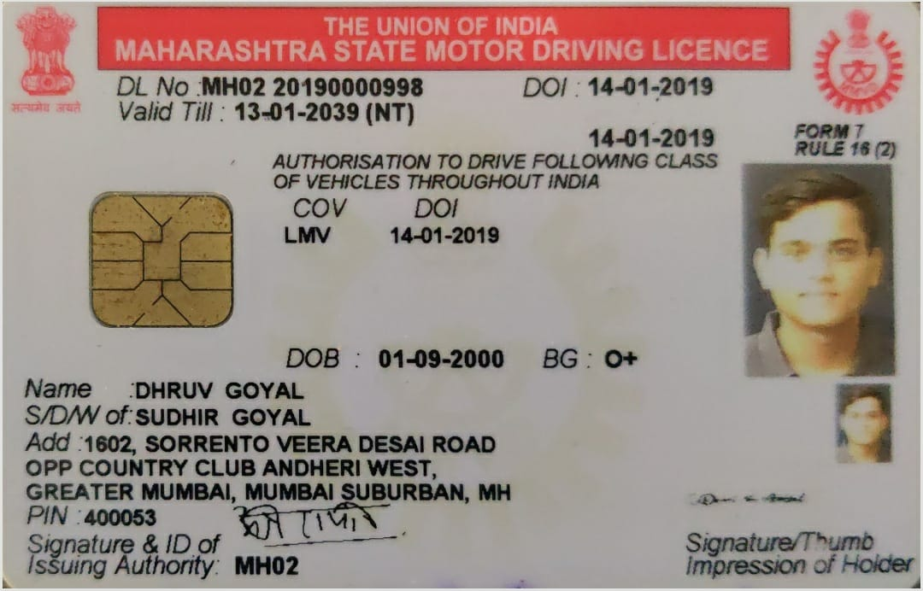
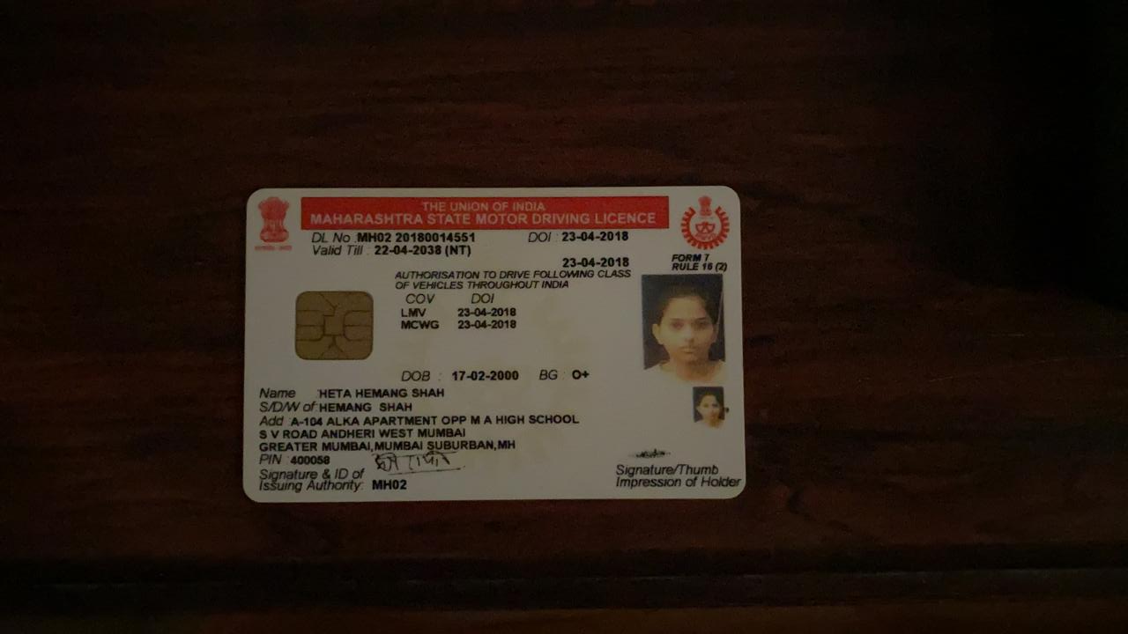
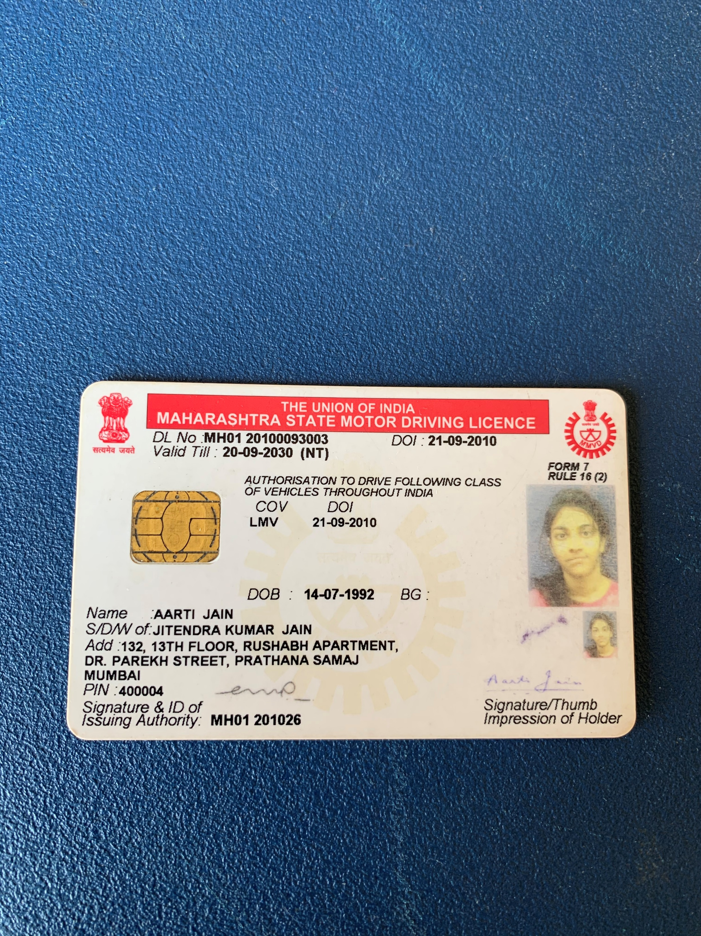
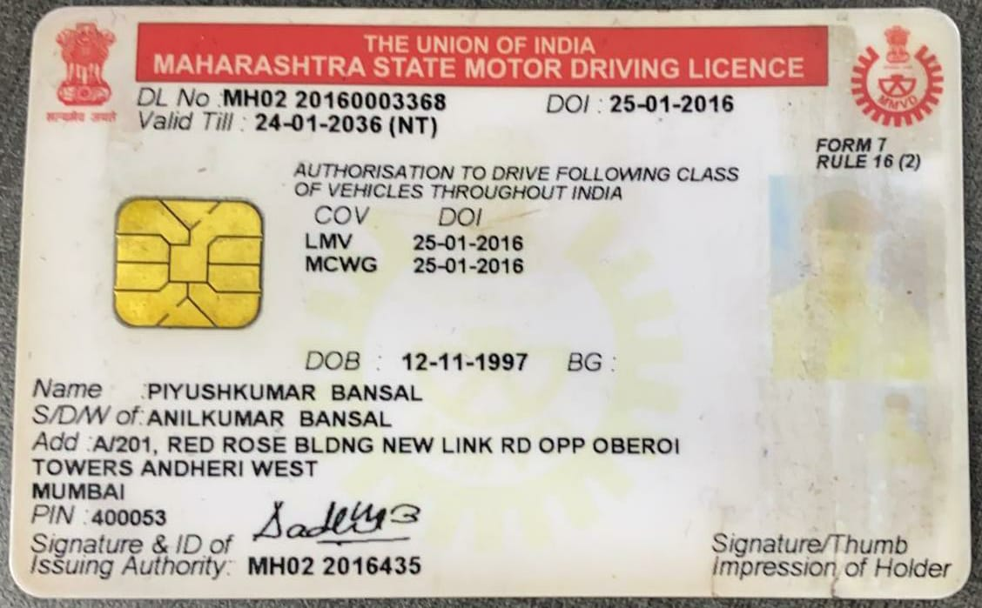
DATABASE
46CARDS
32CARDS
14CARDS
TRAINING SET
TEST SET

Slide 7

1
PROCEDURE
0
8
2
7
3
4
6
5
Notes:
LATER

Slide 8
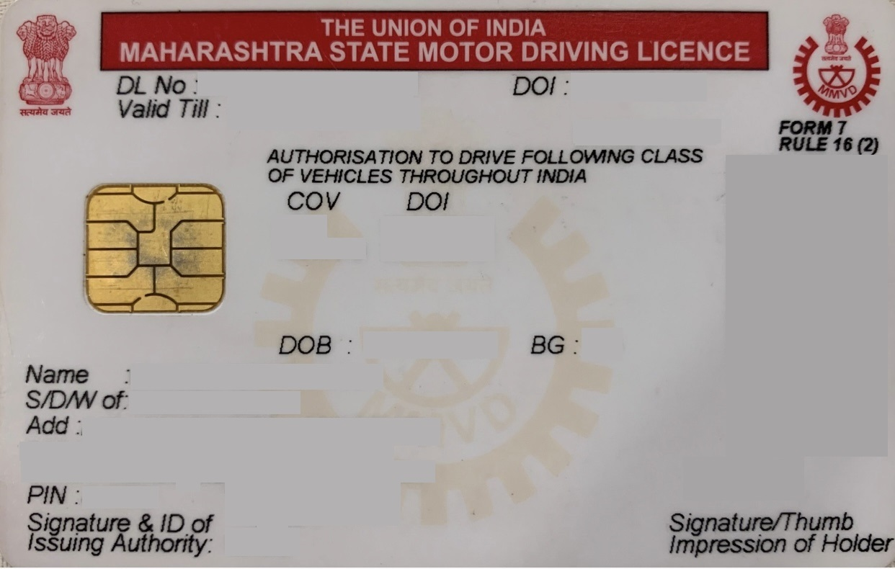
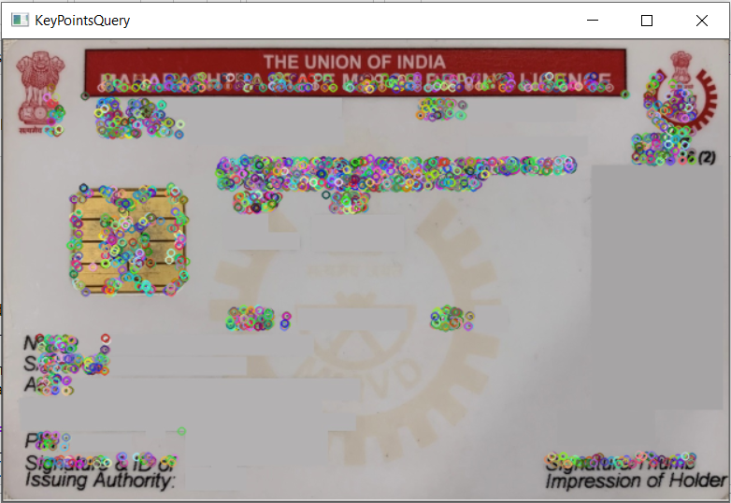
FEATURE DETECTON OF QUERY IMAGE
BEFORE DETECTION
AFTER DETECTION
Notes:
Feature detection of Query Image

Slide 9
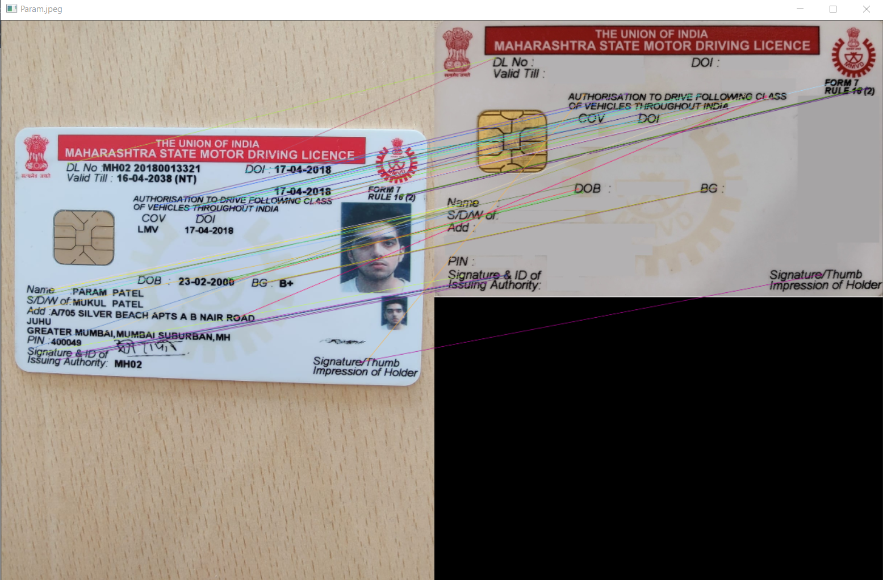
FEATURE LINE MAPPING
SAMPLE
QUERY IMAGE
Notes:
Feature Line Mapping (Feature Detection Mapping)

Slide 10
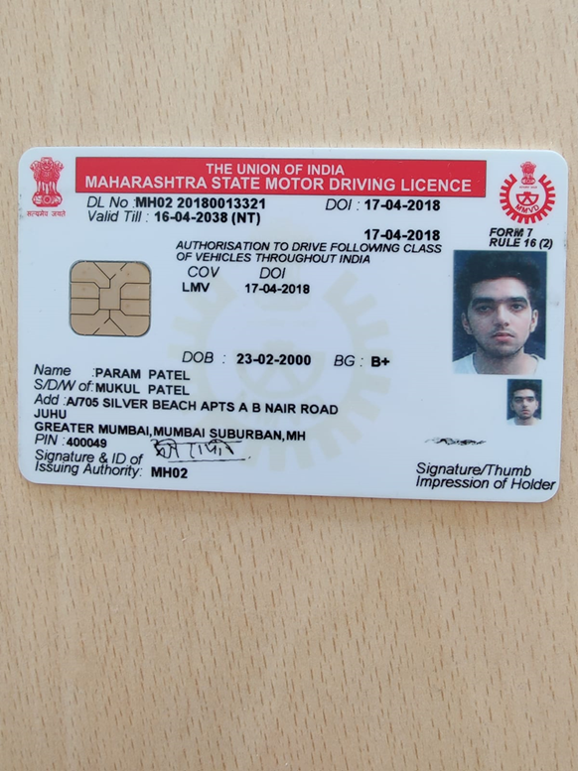
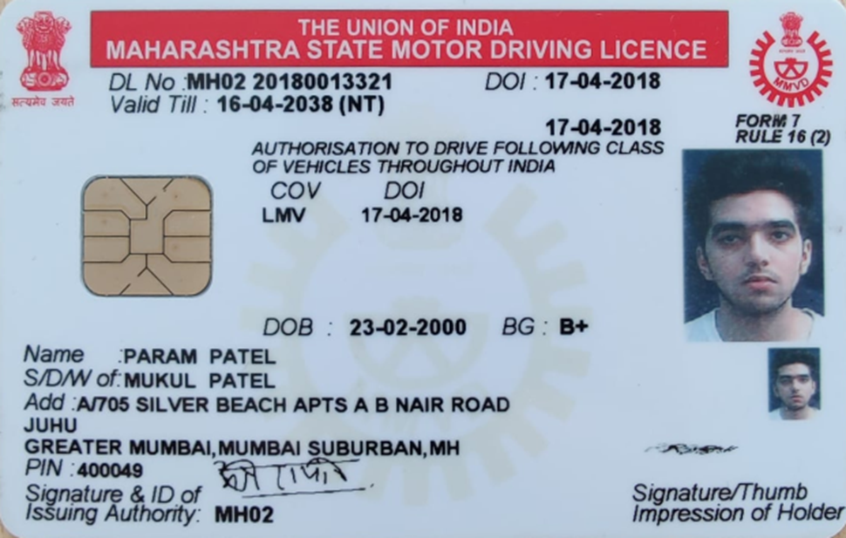
ALIGNING THE LICENSE IMAGE
BEFORE
AFTER
Notes:
Aligning the Licenses/Images

Slide 11
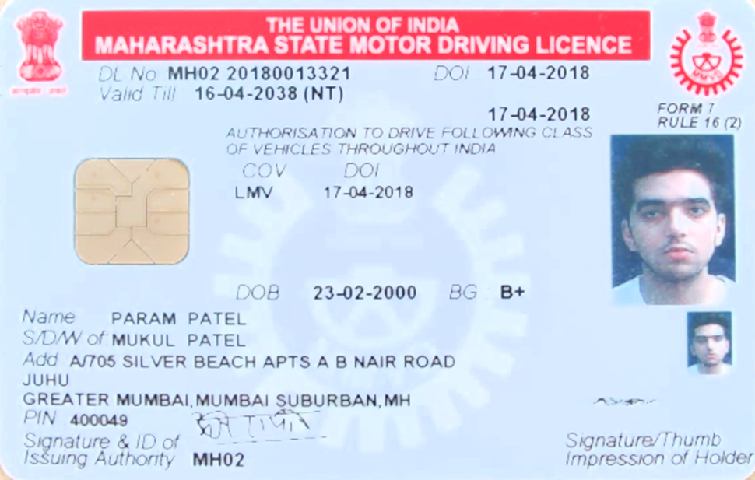
IMAGE PRE-PROCESSING
BEFORE
AFTER
TECHNIQUES USED: INCREASE BRIGHTNESS & DILATION
Notes:
Image Pre-Processing

Slide 12
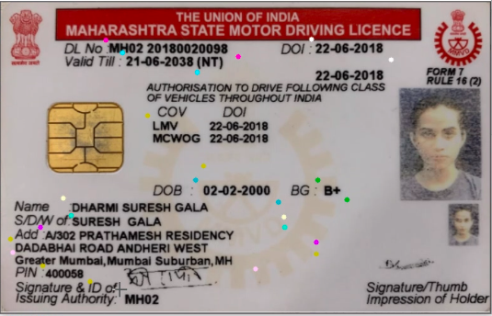
REGION OF INTEREST (ROI) SELECTION
Example:
[[(266, 96), (602, 138), 'DL No'],
[(788, 94), (990, 146), 'Date of Issue']
Notes:
Region of Interest (ROI) Selector-

Slide 13
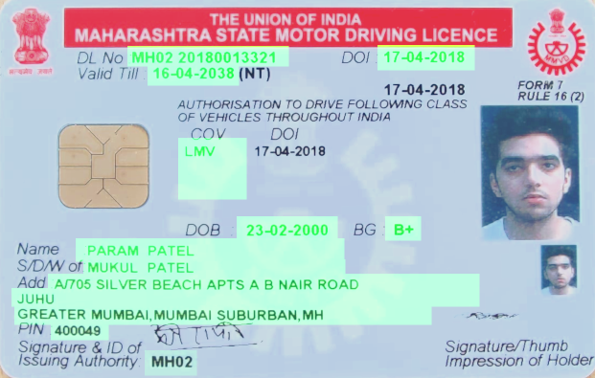
TEXT DETECTION
Notes:
ROI Masking / Text Detection

Slide 14
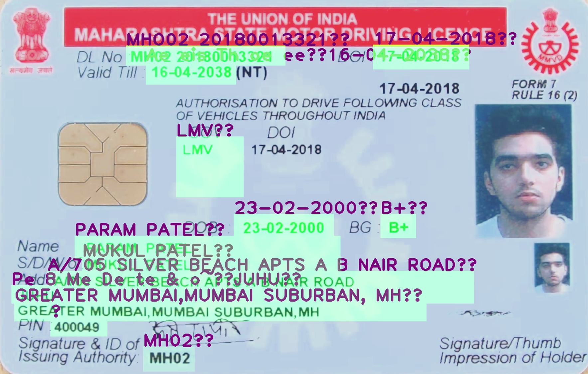
TEXT EXTRACTION
Notes:
Text Extraction & Instant Verification

Slide 15

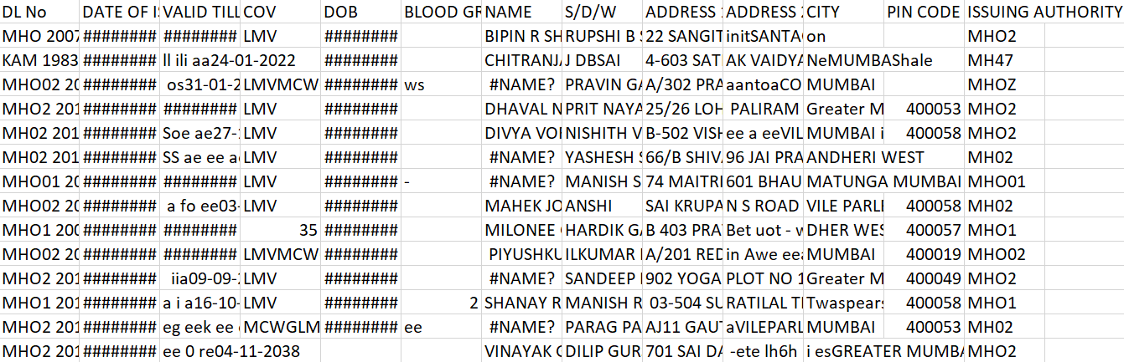
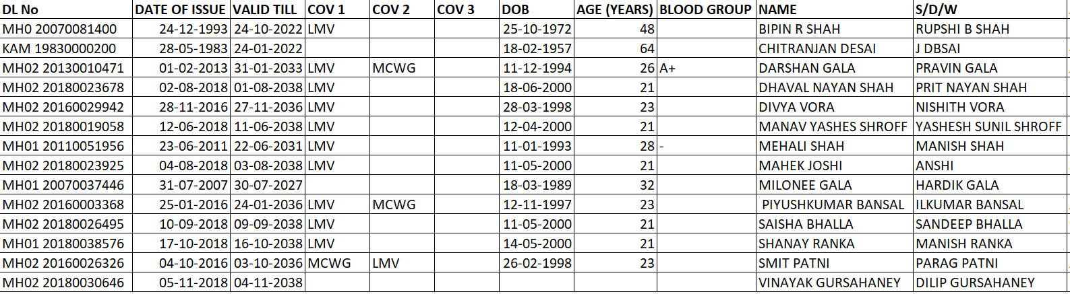
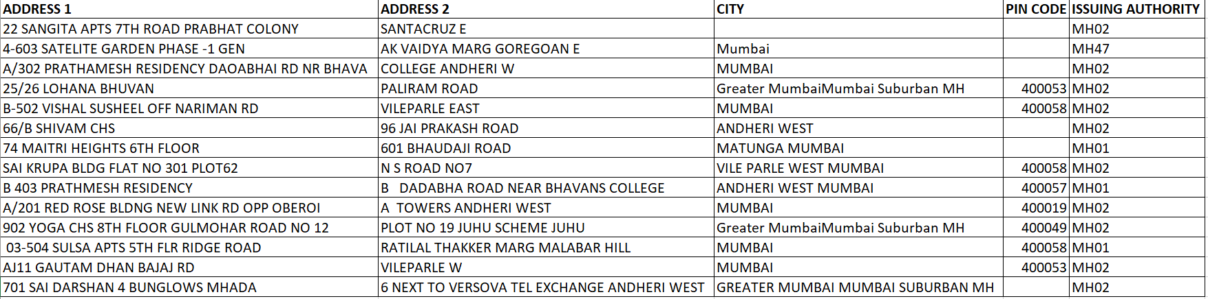
DATABASE CREATION
BEFORE
AFTER using Macros

Slide 16
ACCURACY
02468
01234567890123456789
0123456789
0123456789
0123456789
0123456789
012345678
9
02468
9
01234567890123456789
0123456789
0123456789
0123456789
0123456789
0123456789
0
.65%
.16%
TRAINING SET
TEST SET
DEMONSTRATING THE MODEL →

Slide 17
01234567890123456789
0123456789
0123456789
0123456789
0123456789
0123456789
0
01234567890123456789
0123456789
0123456789
0123456789
0123456789
012345678
9
02468
9
02468
ACCURACY
.65%
.16%
TRAINING SET
TEST SET
DEMONSTRATING THE MODEL →

Slide 18





CONCLUSION
Given model is deployable for widespread usage
Based on readily available softwares
Can be used by layman
Flexibility
Redundancy in existing manual system reduced by:
Eliminates human error
Reduces time and cost
Notes:
Deployment
Efficient

Slide 19
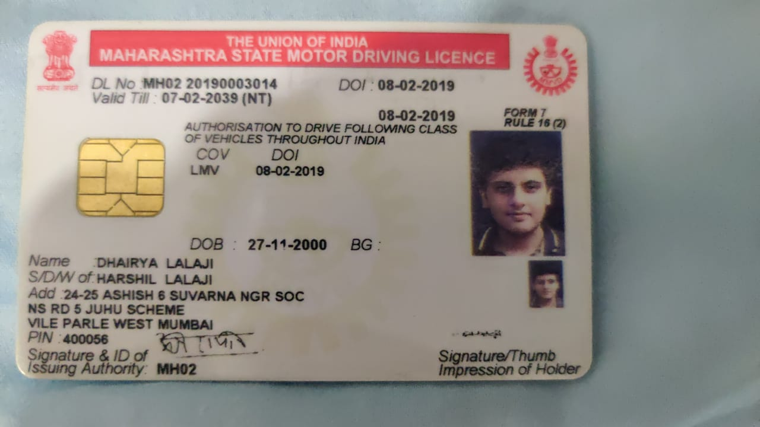
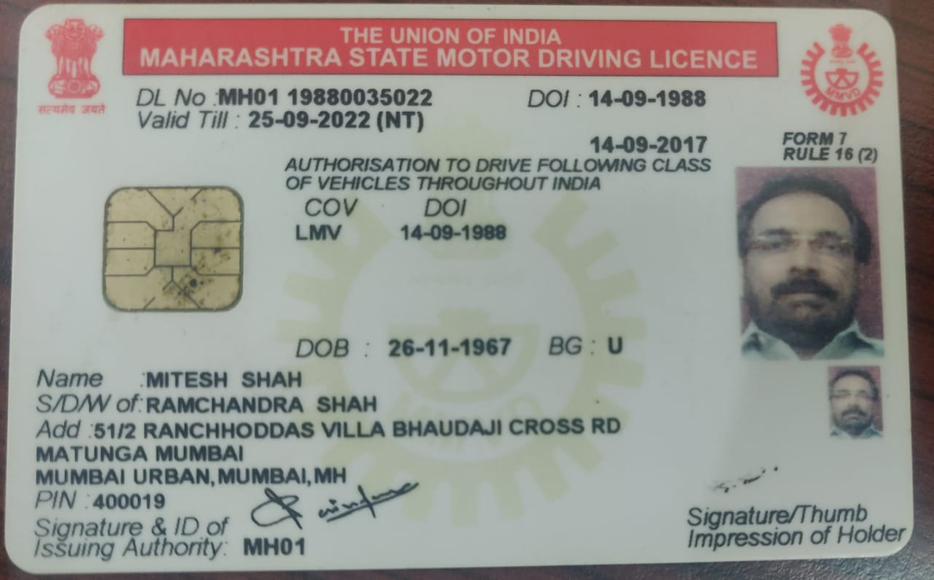
LIMITATIONS
Model’s use is limited to Maharashtra
Blood Group is unstandardised and/or provides false information
100% accuracy has not been achieved:
Pin Code is not read accurately
Notes:
Limitations - Limited to Maharashtra Doesn't have the ideal 100% accuracy Is still a 2 step process
Scope- Limited to real time intergration ( camera ) (instant scanning) (We are still using a 2 step process) Universal to all ID cards Explore the possibility of NN
Address 1 & 2 are a given issue cause it is a very long sentence

Slide 20
LIMITATIONS
Model’s use is limited to Maharashtra
Blood Group is unstandardised and/or provides false information
100% accuracy has not been achieved:
Pin Code is not read accurately
It is yet a 2-step process
FUTURE SCOPE
Extend the model for real time integration via cameras
Applicability to all identity proofs
Exploring the use of Artificial Intelligence (AI)
Notes:
Limitations - Limited to Maharashtra Doesn't have the ideal 100% accuracy Is still a 2 step process
Scope- Limited to real time intergration ( camera ) (instant scanning) (We are still using a 2 step process) Universal to all ID cards Explore the possibility of NN
Address 1 & 2 are a given issue cause it is a very long sentence

Slide 22
OBJECTIVE

Slide 23
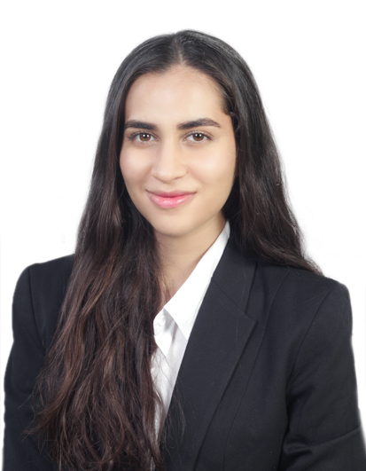
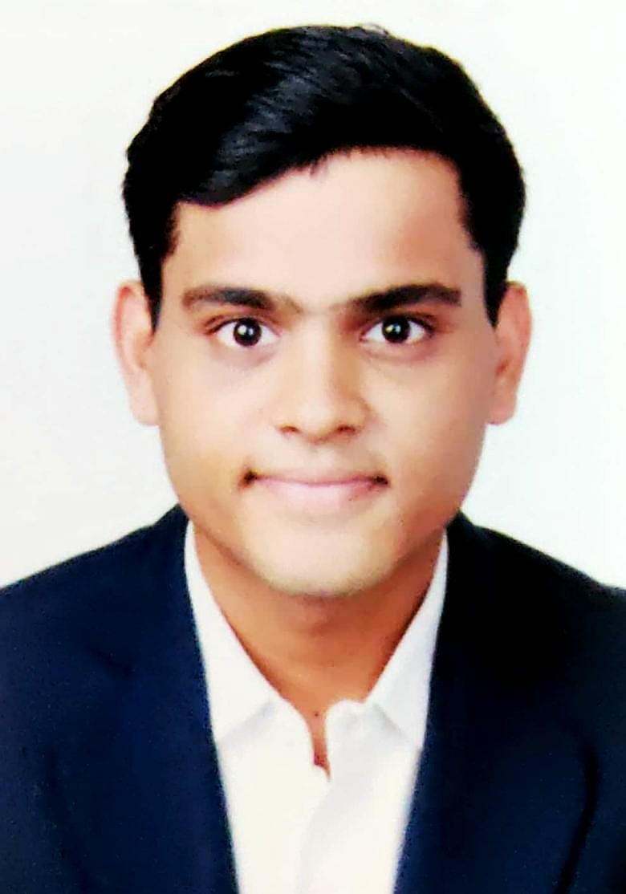
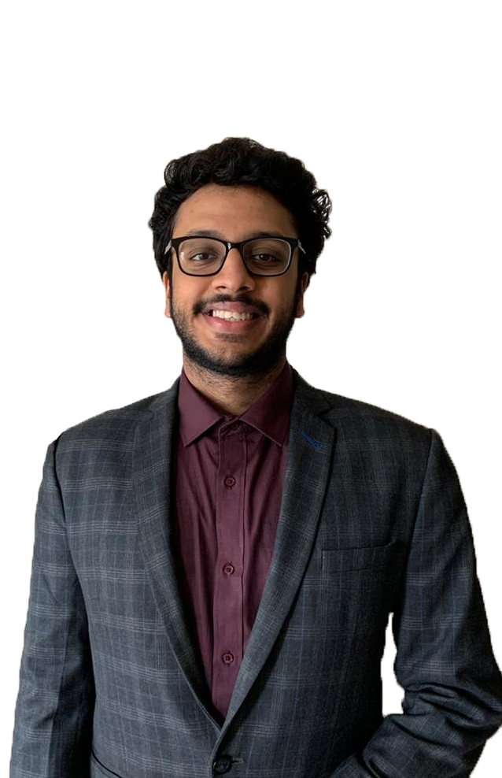
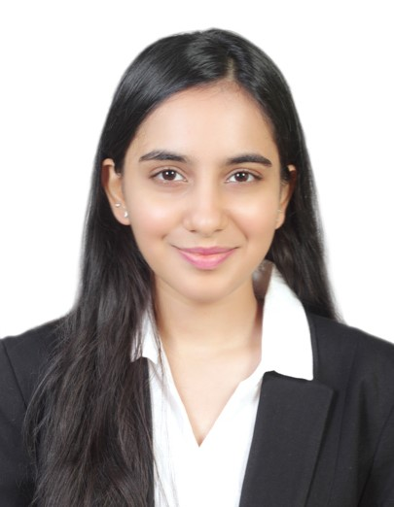
THANK
YOU
Dharmi Gala – A014
Dhruv Goyal – A018
Aman Jain – A021
Mahi Shah – A037

